Slide 1
The math module
The math module in Python provides mathematical functions. It includes variety of functions for performing basic arithmetic, trigonometric operations and more complex mathematical calculations. The math module provides functions for
Basic arithmetic operations
Trigonometric functions
Logarithmic functions
Exponential functions
Mathematical constants
Additional functions such as factorial and gcd

Slide 2
To use math module you first need to import it.
import math
Some commonly used functions in math module are
math.sqrt(x)
math.pow(x,y)
math.sin(x)
math.cos(x)
math.factorial(x)
math.gcd(x,y)
Example
print (pow(3,4))
81

Slide 3
Pseudocodes
Pseudocode
A Pseudocode is a high-level representation of an algorithm that uses a mixture of natural language and programming language-like syntax.
It is more structured than an algorithm in that it uses mathematical expressions with English phrases to capture the essence of a solution concisely.
programming constructs can be used in a pseudocode
independent of any programming language

Slide 4
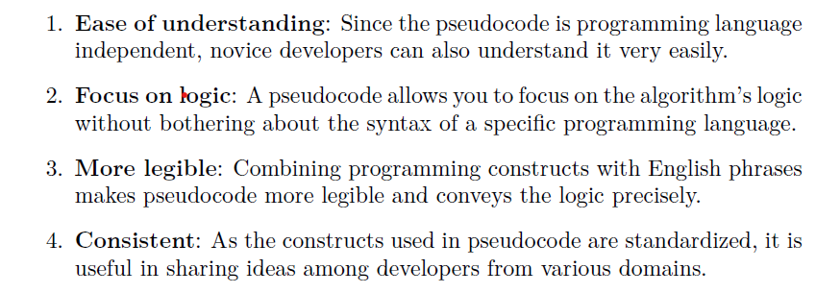
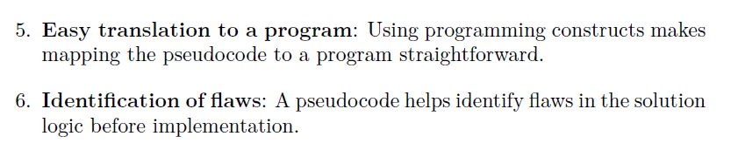
Why pseudocodes?

Slide 5
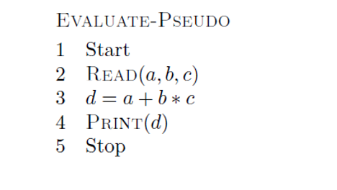
Example d = a + b ∗ c.

Slide 6
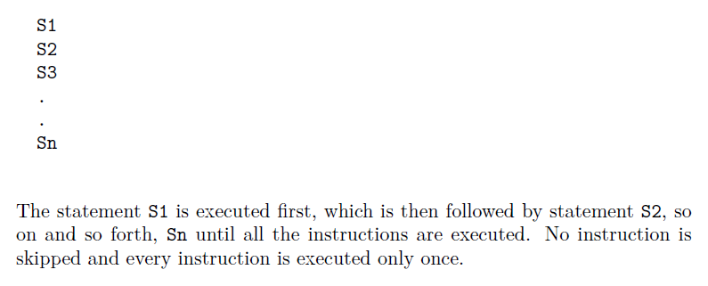
Constructs of a pseudocode
Sequence

Slide 7
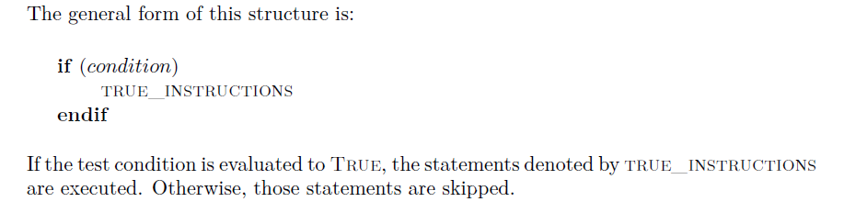
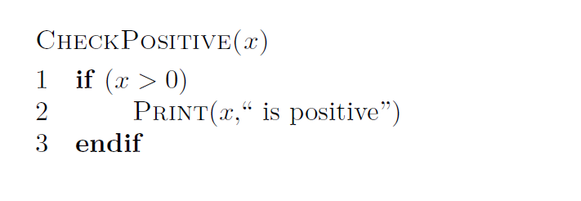
Decision or Selection
If statement
The pseudocode CheckPositive(x) checks if an input value x is positive.

Slide 8
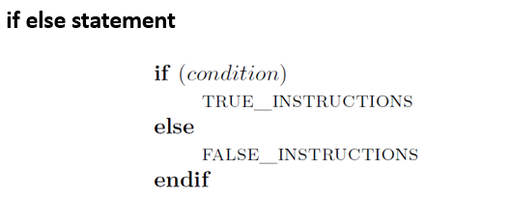
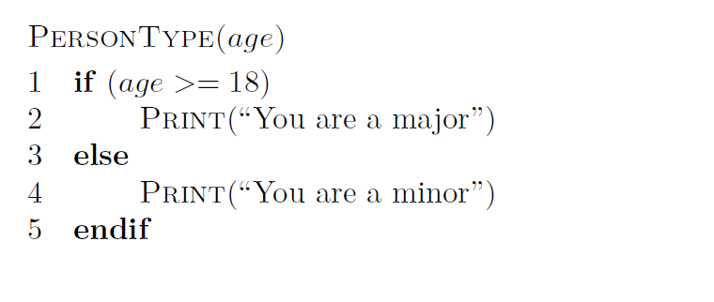

Slide 9
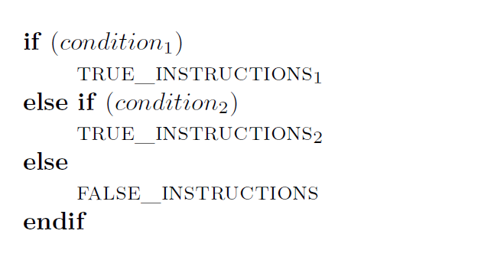
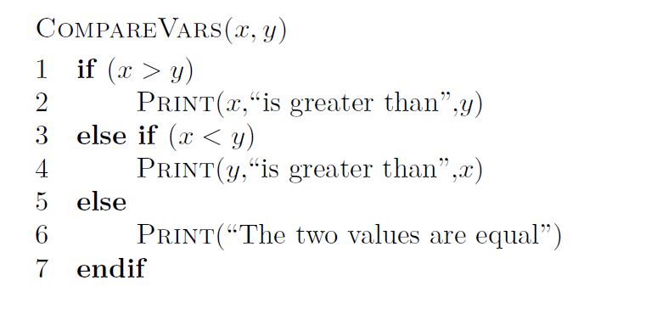
elif statement

Slide 10
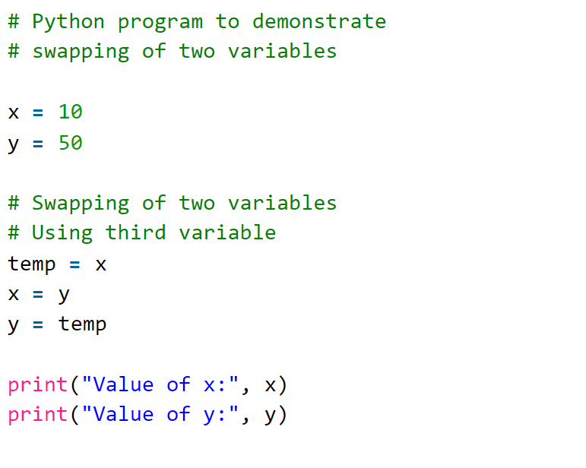
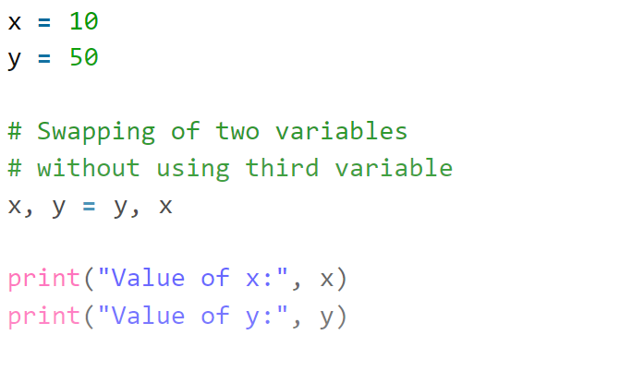
Swap two values

Slide 11
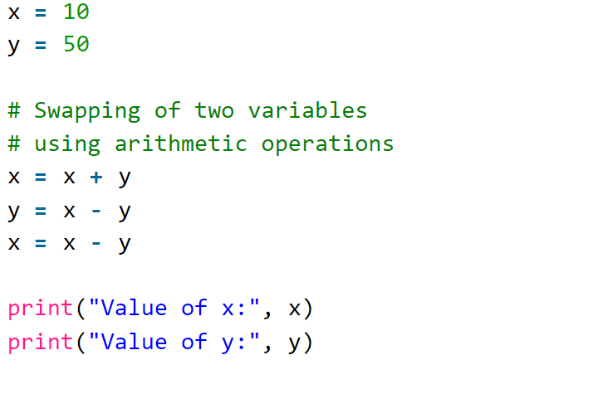
Using addition and subtraction operator :

Slide 12
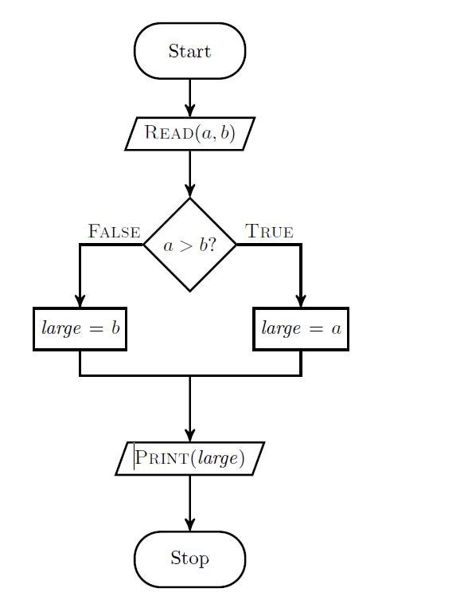
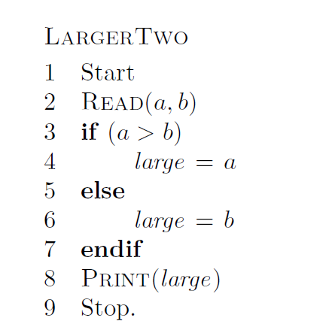
To determine the larger of two numbers

Slide 13
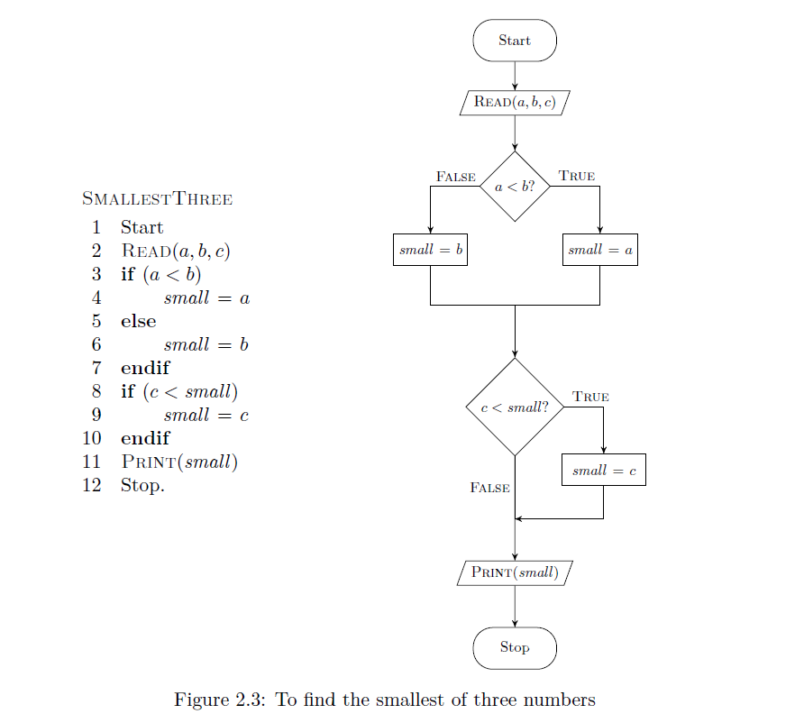

Slide 14
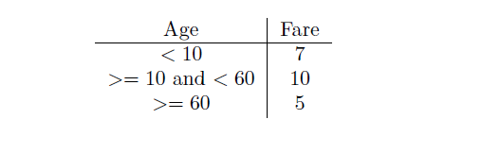
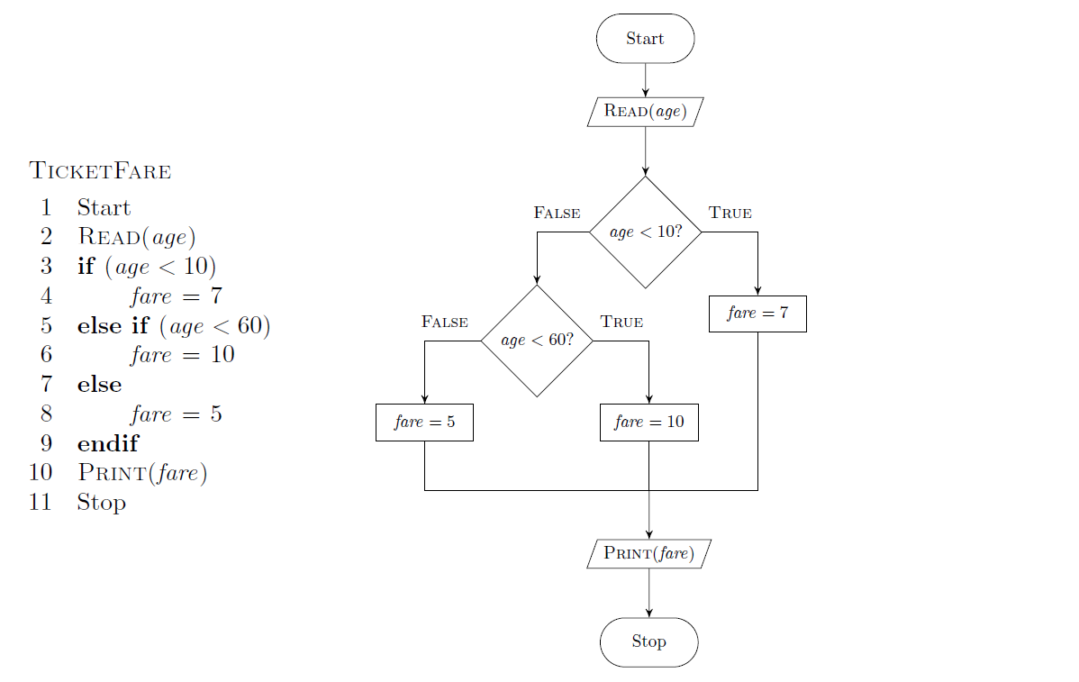
To determine the entry-ticket fare in a zoo based on age as follows

